Slide 1


Agenda
Welcome
Continuous Delivery with TeamCity
Sebastian Tecsi, Solution Architect @Addition
Break
Best practices in a multi site solution
Vlad Iobagiu, MVP - (skype call from airport)
Break
Sitecore v8.1 new features
Daniel Mocan, Solution Architect @Addition

Slide 2

Continous Delivery with Sitecore

Slide 3
Sebastian Tecsi
Sitecore Solution Architect
Working with Sitecore for 9 years
Certified Sitecore 5, 6 and 8

Slide 4
What is Continous Delivery?
“reduce deployment cycle and increase stability and reliability through automation”

Slide 5
Why Continous Delivery?
It fits with our Agile approach
Reduce Cycle time
Takes the pain out of releases
Continuous Feedback

Slide 6
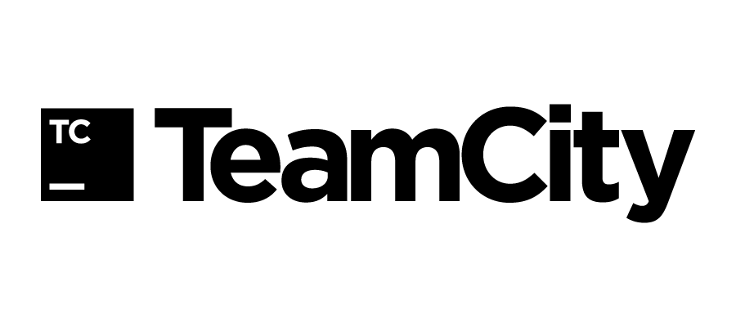





Tools

Slide 7
How to do it?
Developer Commits Changes
Build Solution
TDS Creates Sitecore Update Package
Deploy Sitecore Update Package
Create & Publish NuGet Packages For Deployment
Deploy Application
Install Sitecore Update Package
Create Octopus Release

Slide 8
Demo time!

Slide 9
What can be improved ?
Automation for backups
Config transformations
Run Sitecore Publish
Roll-back
Re-indexing

Slide 10
Questions and answers

Slide 11
Thank you
Twitter: @sebastiantecsi
Email: set@addition.dk
Blog: https://xtremdev.wordpress.com/

